Slide 1
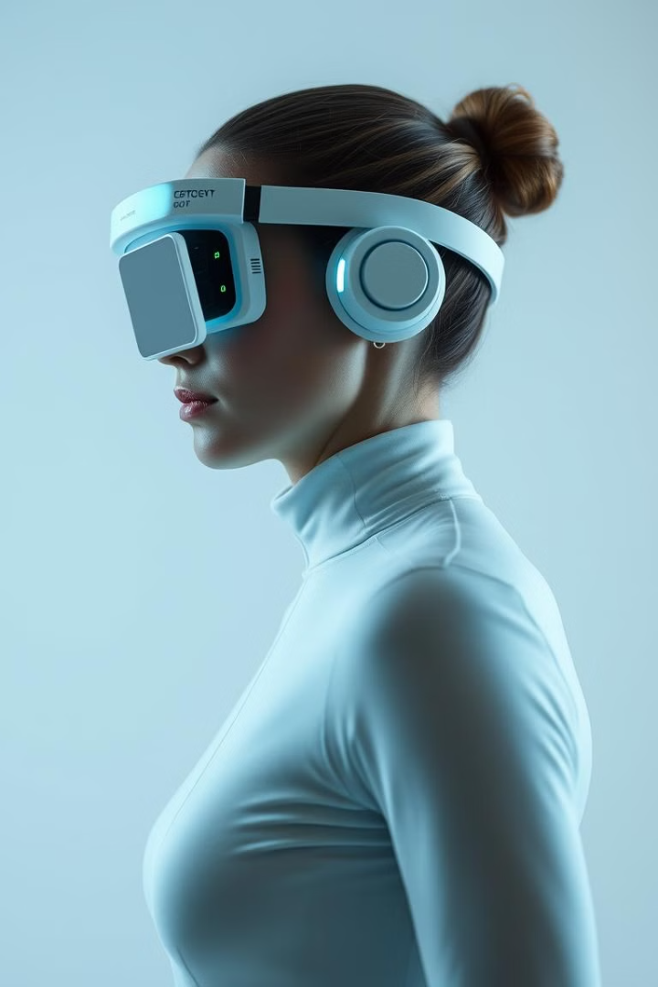
Real-Time Human Motion Capture Using Wearable Sensors
An in-depth exploration of the Real-Time Human Motion Capture system, highlighting its design, methodology, and applications. This project leverages wearable sensors to track human movement with high accuracy, enabling applications in healthcare, sports, and animation.
ABHISHEK S

Slide 2
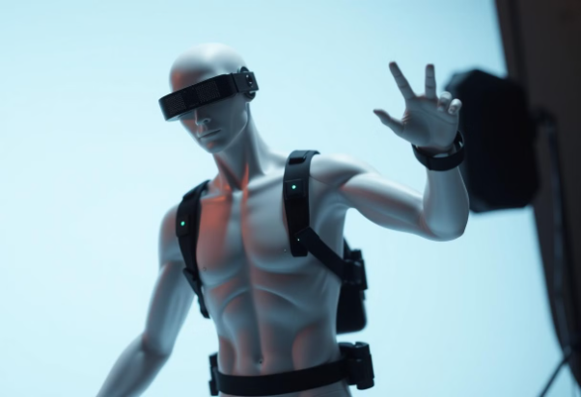
INTRODUCTION
Advanced Tracking
Wearable & Portable
Tracks human movement in real-time with high accuracy, capturing subtle details.
Small sensors attach easily to the body for unrestricted movement.
Versatile Uses
Used in entertainment, sports, healthcare, and VR, with wide-ranging applications.

Slide 3
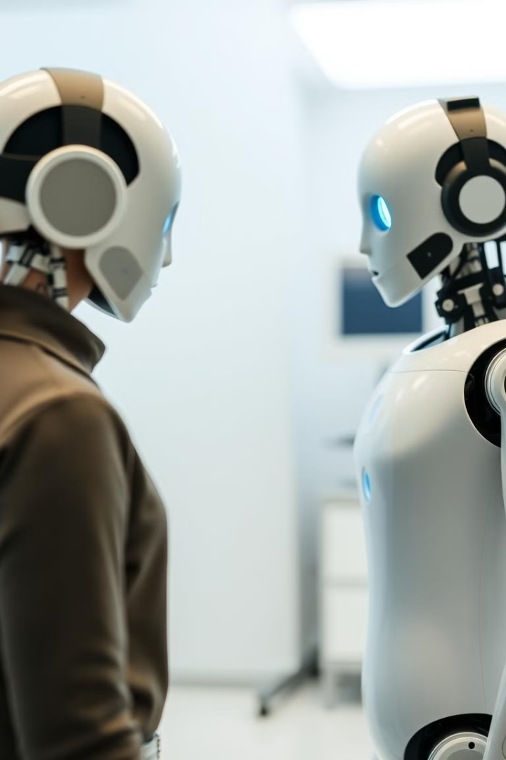
Objective of the Project
1
Accurate Motion Capture
Capturing motion of arms, legs, and torso.
2
Real-Time Feedback
Providing instant motion feedback to the user.
3
Portable & Low-Cost
Alternative to traditional systems.
4
Uncontrolled Environments
Motion capture outdoors or in crowded spaces.

Slide 4
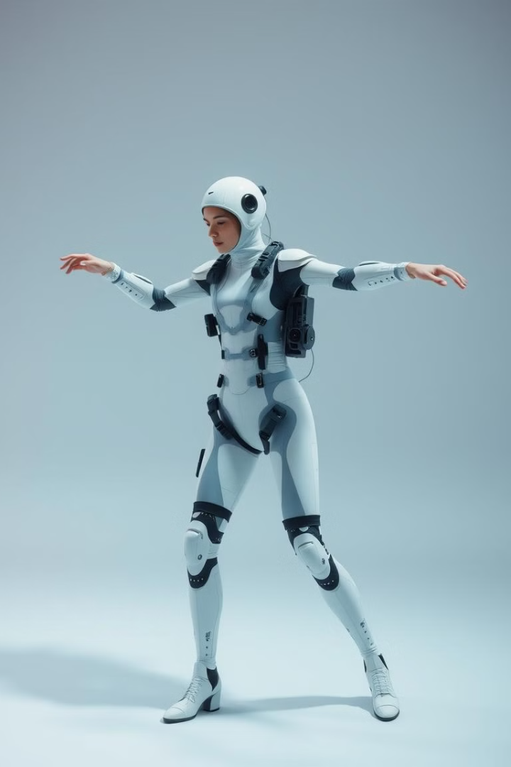
Problem Identification & Proposed Solution
Problem
Proposed Solution
Uncomfortable and bulky wearable suits.
Modular components attached to clothing.
Limited sensors reduce efficiency.
Customizable to body type.
High expense.
Stretchable materials for comfort.

Slide 5
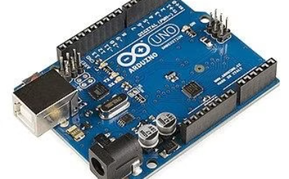
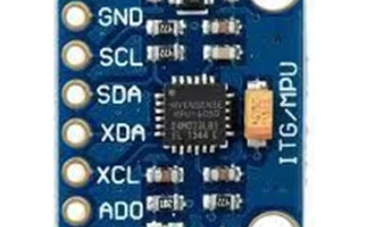
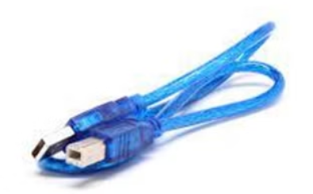
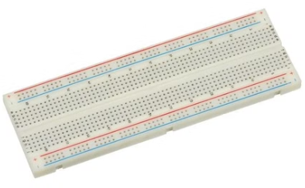
Components Required
Arduino UNO
MPU6050
USB Cable
Bread Board

Slide 6

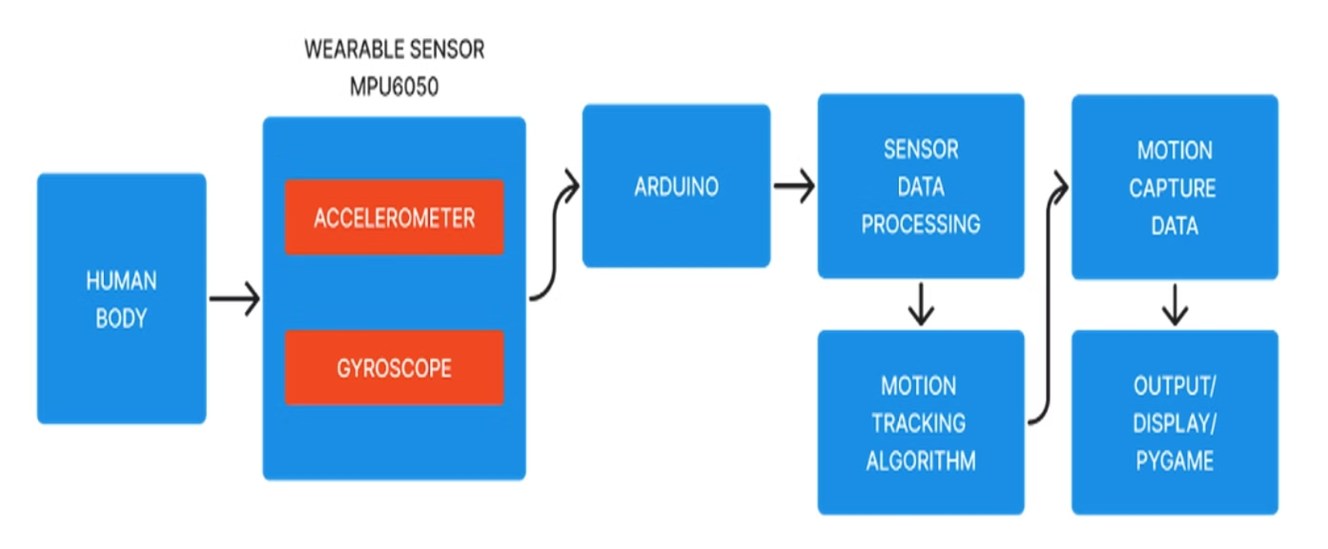
BLOCK DIAGRAM

Slide 7
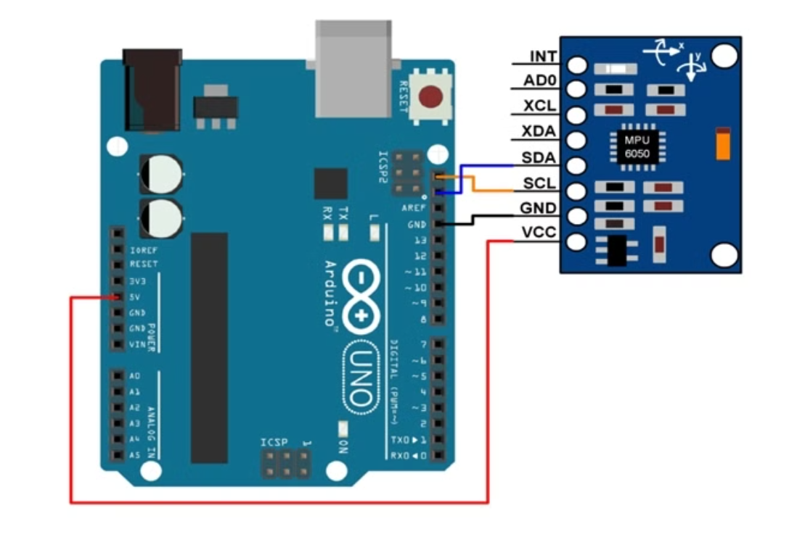
CIRCUIT DIAGRAM

Slide 8





METHODOLOGY
Sensor Selection
IMU sensors measure acceleration and angular velocity.
Sensor Placement
Accurate capture of body part motion.
Data Acquisition
Wireless data transmission to microcontroller.
Data Processing
Orientation estimation via software algorithms.
Real-Time Feedback
Displayed on computer screen for adjustments.

Slide 9
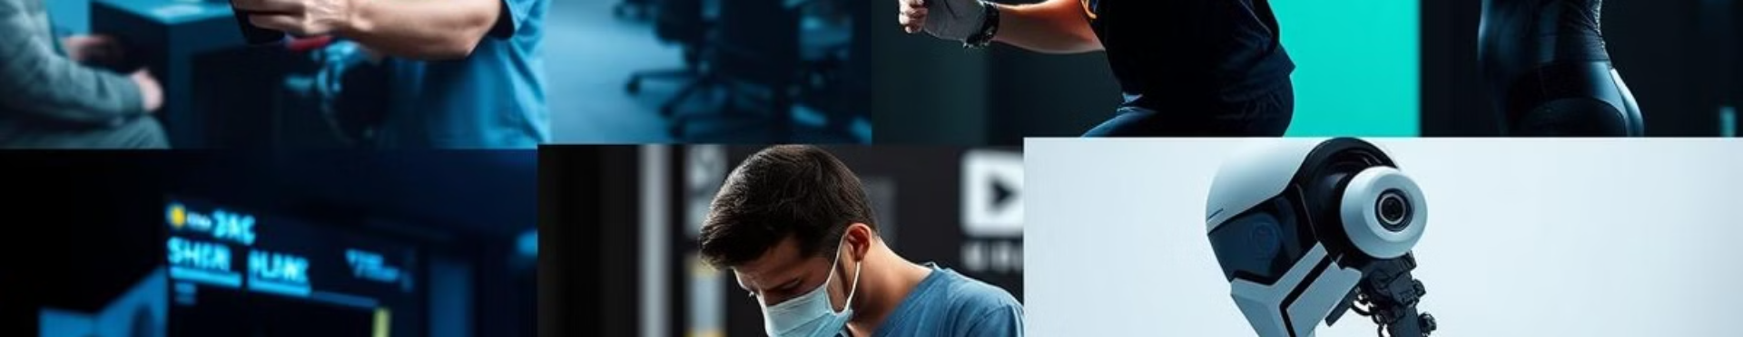




APPLICATIONS
Gaming
Sports
Healthcare
Robotics
Character animation and immersive experiences.
Analyzing athletic performance and training.
Rehabilitation and remote patient monitoring.
Controlling robots with human motion.

Slide 10
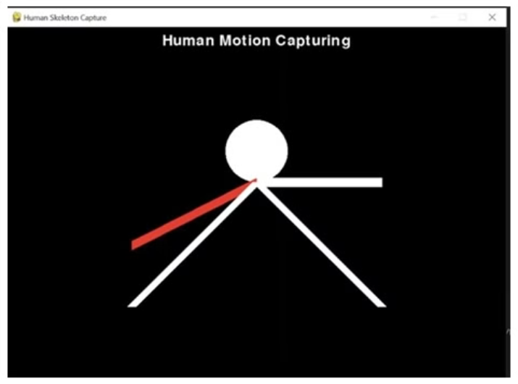
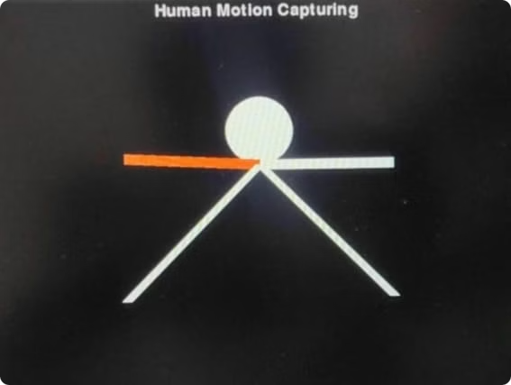
RESULTS
Accurate real-time motion capture achieved.
Portable and low-cost system developed.

Slide 11

CONCLUSION
Promising technology with wide applications.
Accurate, portable, and low-cost motion capture.
Real-time feedback for instant adjustments.
Potential for innovation in various fields.

Slide 12


